Slide 1

MOVIES: Using Machine Learning to Predict Key Metadata
CONFIDENTIAL
Seth Kim
Trong
Andrew
Devang

Slide 2
What are key attributes of movies?
Question
Credits
I
Box Office Gross
Could we predict financial success of a movie before the movie is released?
Seth Kim
II
Recommended Movies
Using key words or desired plot, could we recommend relevant movies?
Andrew
II
Genre
Just for fun, could we predict the genre of a movie just by plot?
Trong
Produced by: Devang

Slide 3
Box Office Gross
I
Model: Multiple Linear Regression
Initial Features
Used Features
Filter & Cleansing
Number of critic for reviews
Duration
Director facebook likes
Actor 1 facebook likes
Actor 2 facebook likes
Actor 3 facebook likes
Cast total facebook likes
Face number in poster
Number User for Reviews
Rating (G, PG, PG-13, R)
Budget
Movie facebook likes
Number of voted users
IMDB Score
Movie facebook likes?
Duration
Director facebook likes
Actor 1 facebook likes
Actor 2 facebook likes
Actor 3 facebook likes
Cast total facebook likes
Rating (G, PG, PG-13, R)
Budget
R² = XX.XX
MSE = XX.XX
Stepwise Linear Regression + Dummy Variables

Slide 4
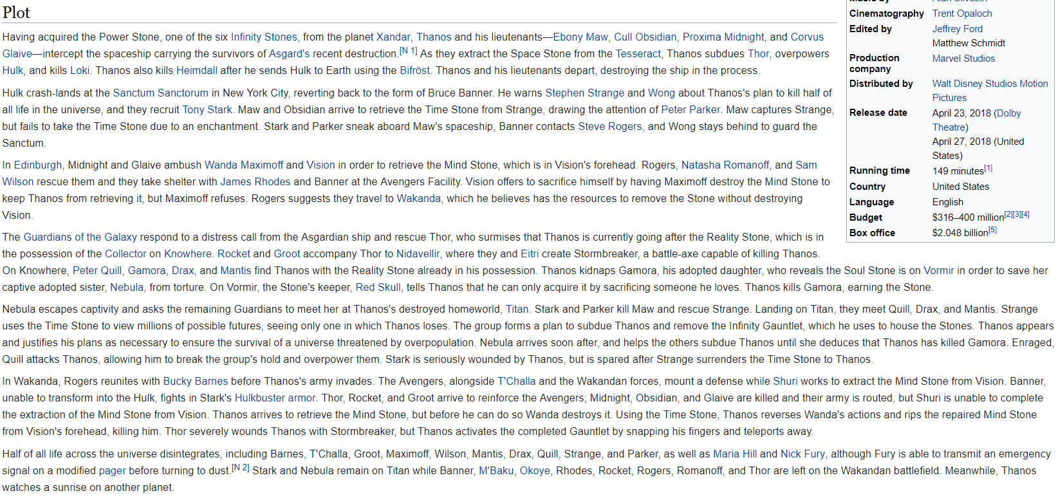
Predicting the Genre of a Movie using Machine Learning
I
Given the plot of a movie, can we predict that movie’s genre, with a reasonable accuracy?

Slide 5
Predicting the Genre of a Movie using Machine Learning
I
ANSWER:
We can try!

Slide 6

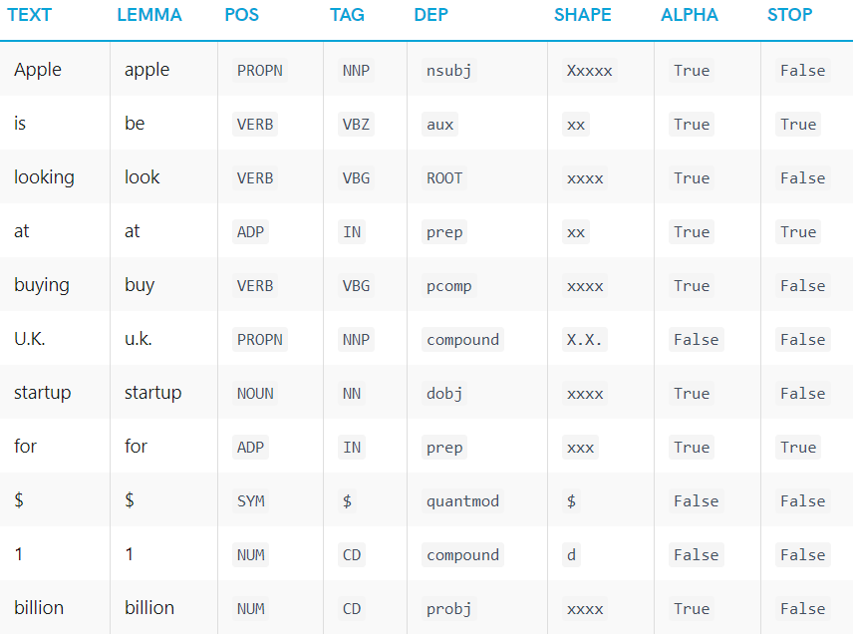
Predicting the Genre of a Movie using Machine Learning
I

Slide 7
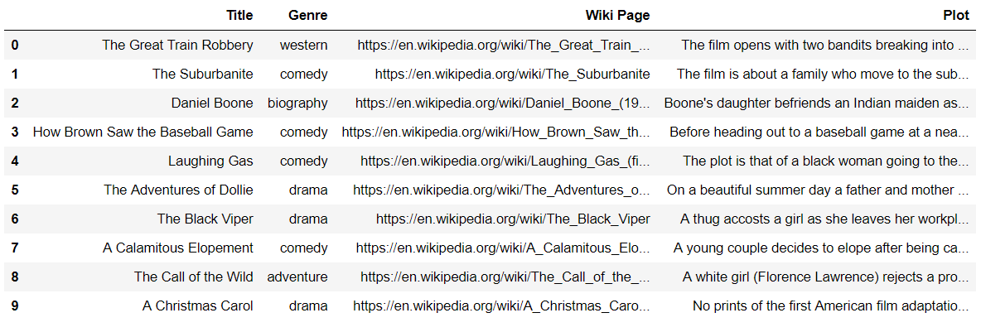
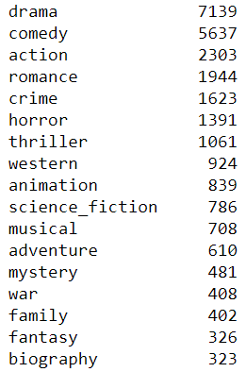
Predicting the Genre of a Movie using Machine Learning
I

Slide 8
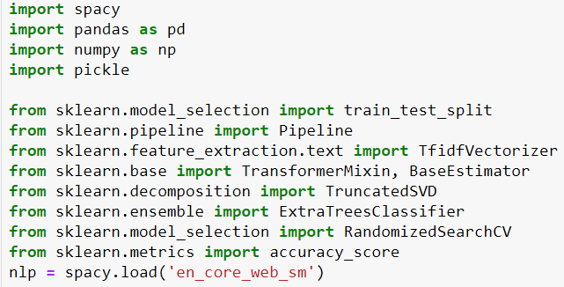
Predicting the Genre of a Movie using Machine Learning
I

Slide 9
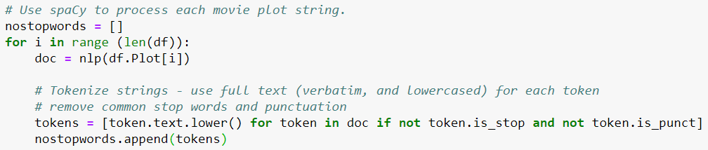
Predicting the Genre of a Movie using Machine Learning
I

Slide 10
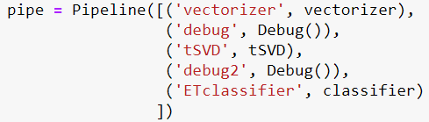
Predicting the Genre of a Movie using Machine Learning
I

Slide 11

Predicting the Genre of a Movie using Machine Learning
I

Slide 12

Predicting the Genre of a Movie using Machine Learning
I
The random forest is a model made up of many decision trees. Rather than just simply averaging the prediction of trees (which we could call a “forest”), this model uses two key concepts that gives it the name random:
Random sampling of training data points when building trees
Random subsets of features considered when splitting nodes
Extra Trees: EXTreme RAndom forests
Random Forest splits are deterministic (locally optimal)
Extra Trees splits are the best split among random uniform splits in the selected variables for the current tree.
This leads to more diversified trees and less splitters to evaluate when training an extremely random forest (faster runtime!)

Slide 13
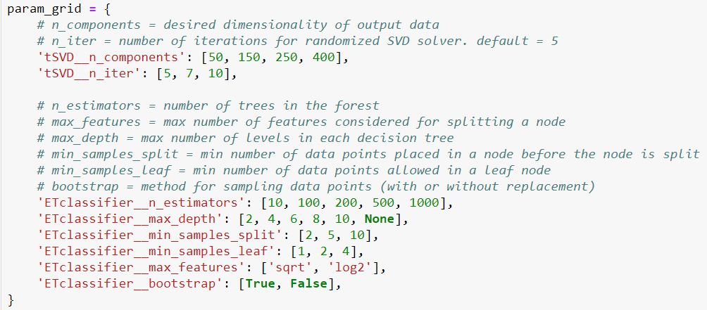
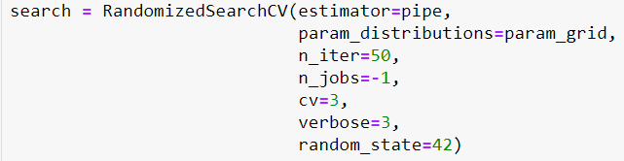
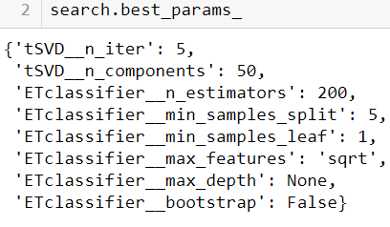
Predicting the Genre of a Movie using Machine Learning
I

Slide 14
Predicting the Genre of a Movie using Machine Learning
I
All that and what do we get?

Slide 15
Predicting the Genre of a Movie using Machine Learning
I
All that and what do we get?

Slide 16
Predicting the Genre of a Movie using Machine Learning
I

